Slide 1
Bootstrap Templates
Week 10 - Create and Host a Static Webpage

Slide 2
Once more into the breach!
First download the Bootstrap Examples
https://getbootstrap.com/docs/5.0/examples/
Unzip the files
Move the folder into your projects folders
Check out some of the examples

Slide 3
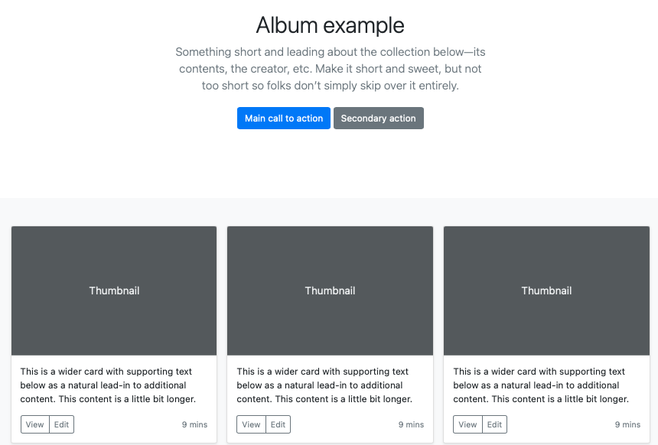
Album example Great for presenting something that is very image centric

Slide 4
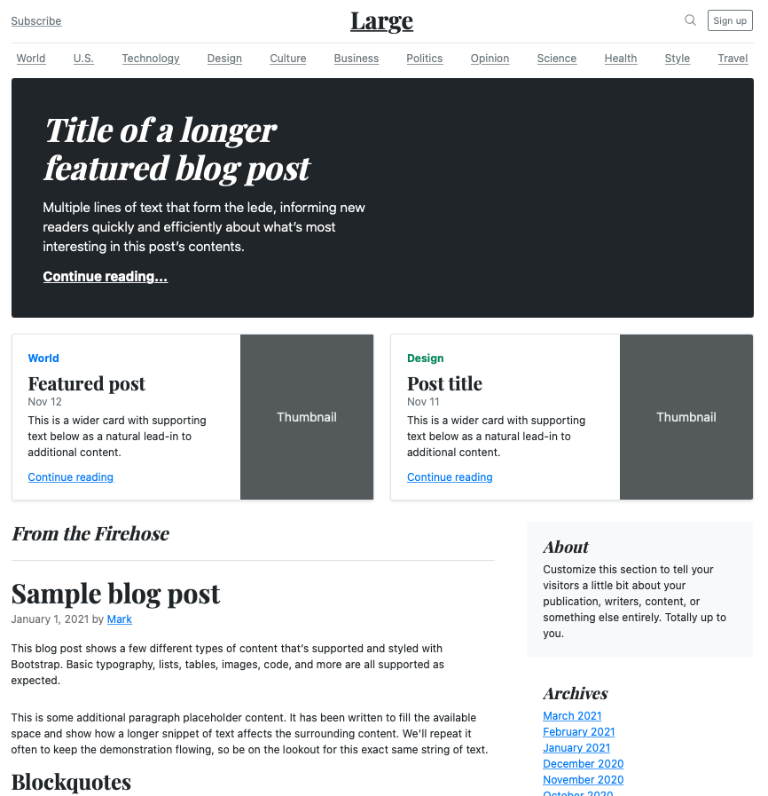
Blog example

Slide 5
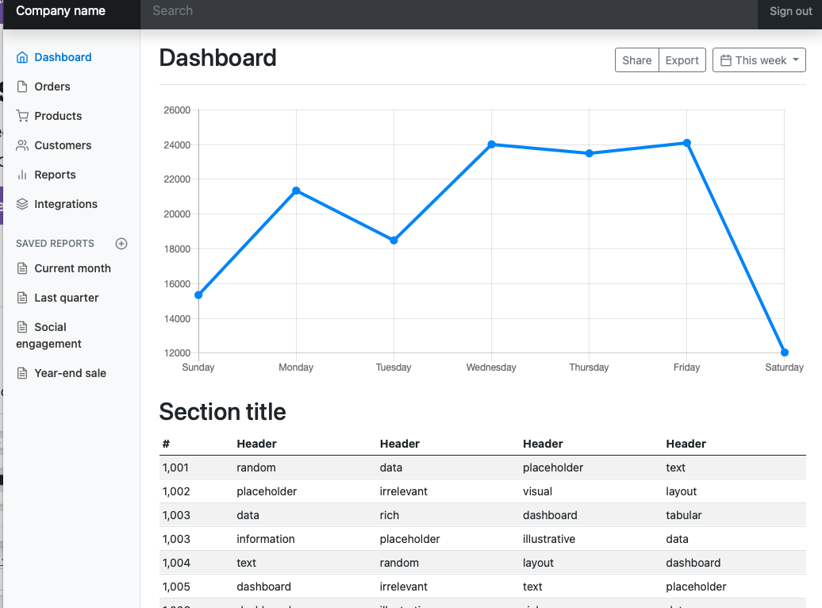
Dashboard example

Slide 6
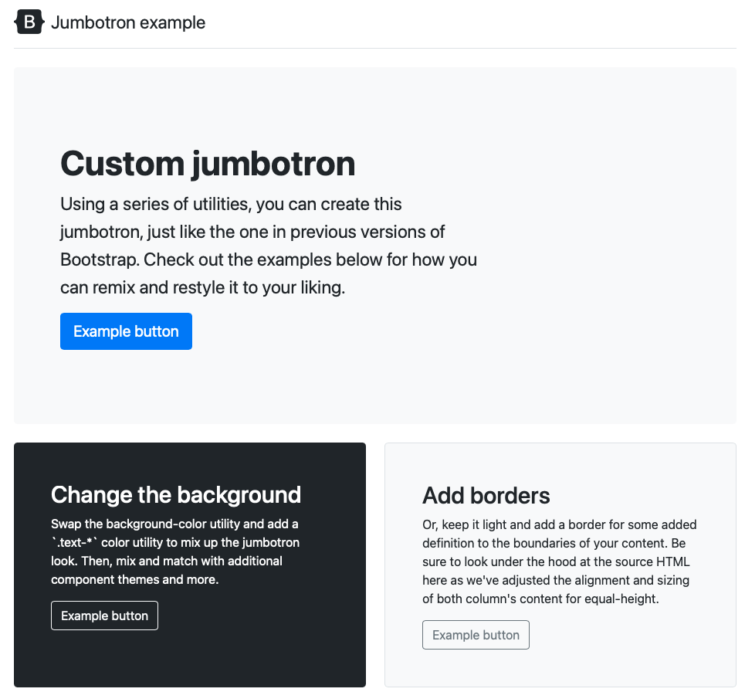
Jumbotron example The famous

Slide 7
Choose an example and make it your own

Slide 8
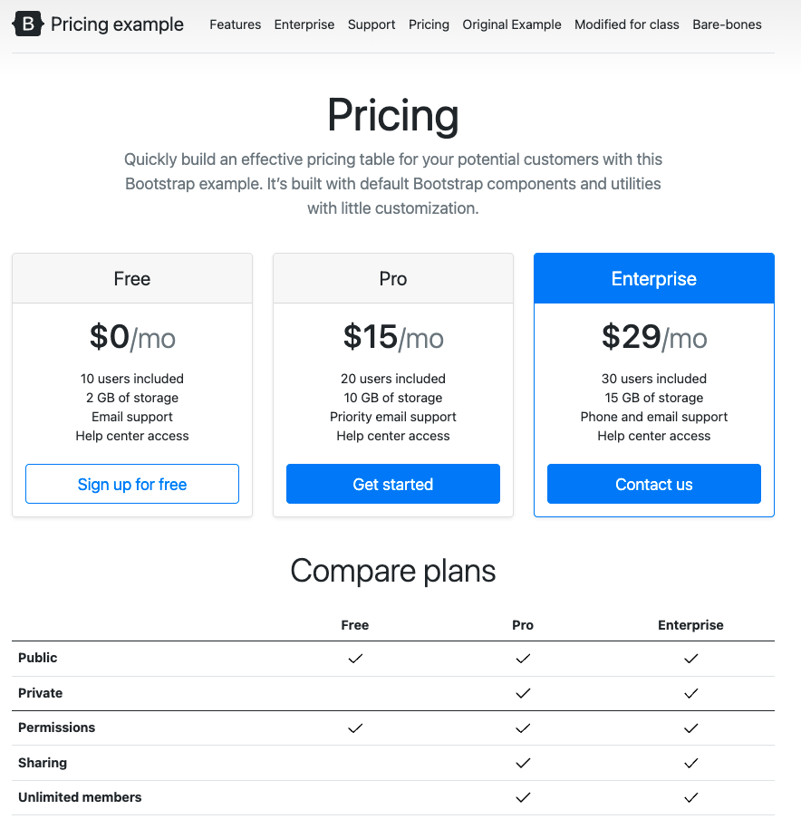
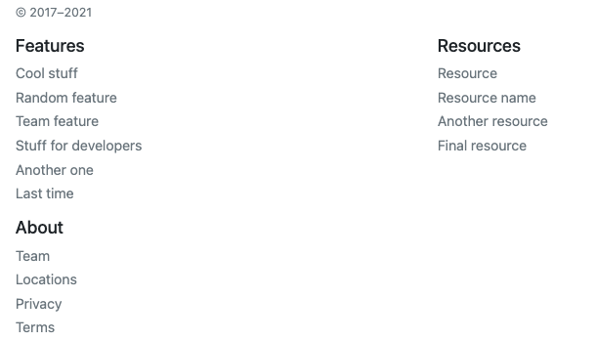
I Chose the ‘Pricing’ example
Nice for showing different levels of service
Compare them side-by-side
Good Navigation
Nice footer

Slide 9
I’ll use it to give a snapshot of our class
What is the course about?
What happens each week?
Where are the tests?
When are the assignments?

Slide 10
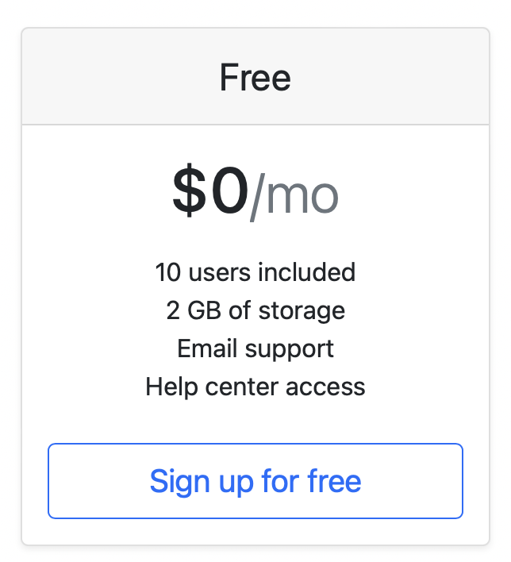
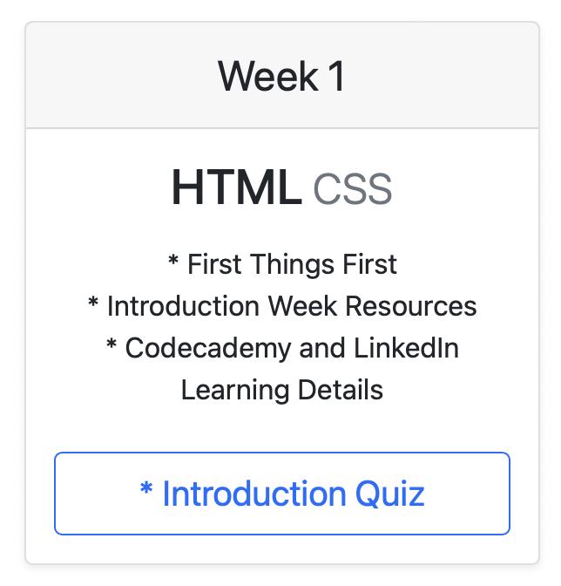
Good Programmers Borrow; Great Programmers Steal (Politely)
Do not recreate the wheel!
You are paid to produce a product not write lines of code
Original My Version

Slide 11
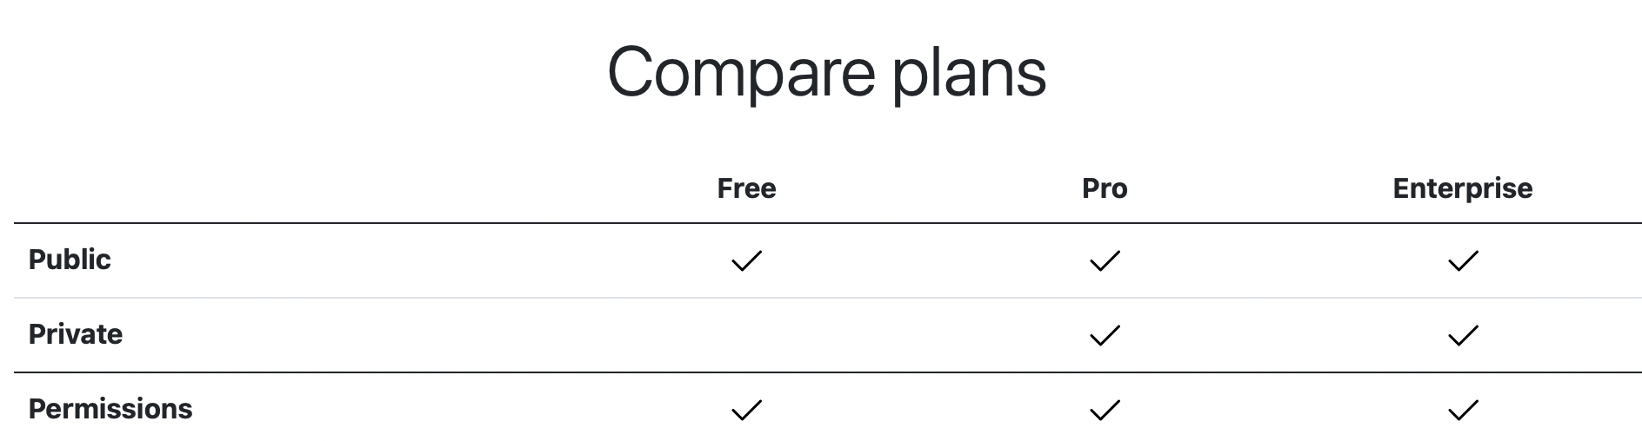
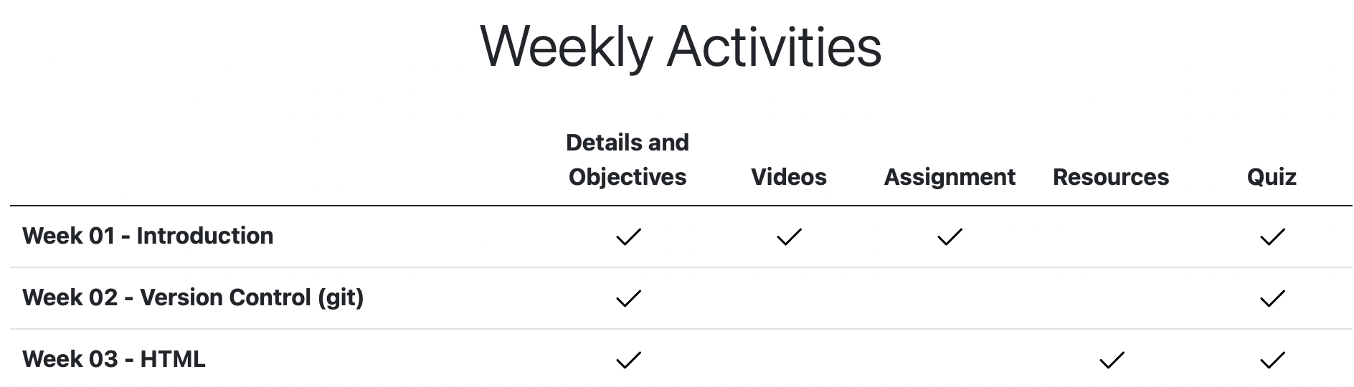
Make sure you understand what you are doing
Original
My version

Slide 12
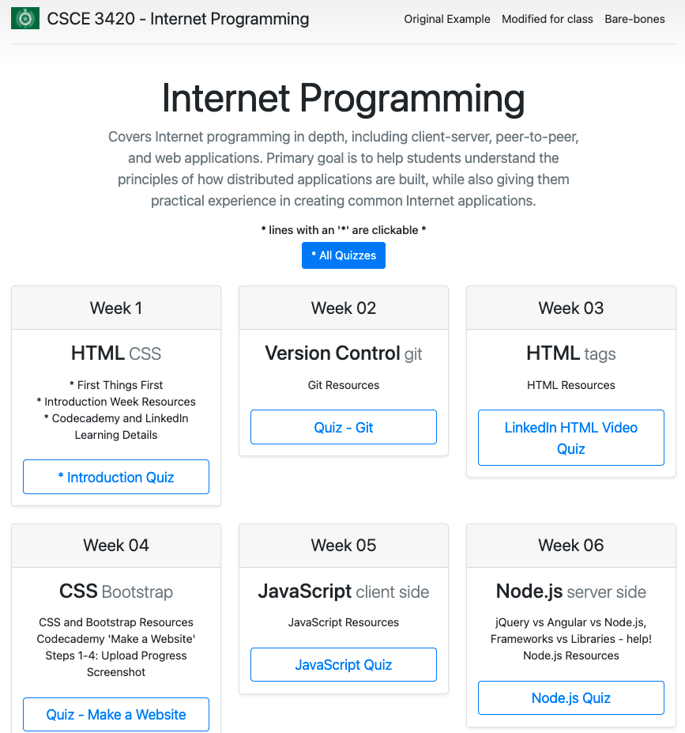
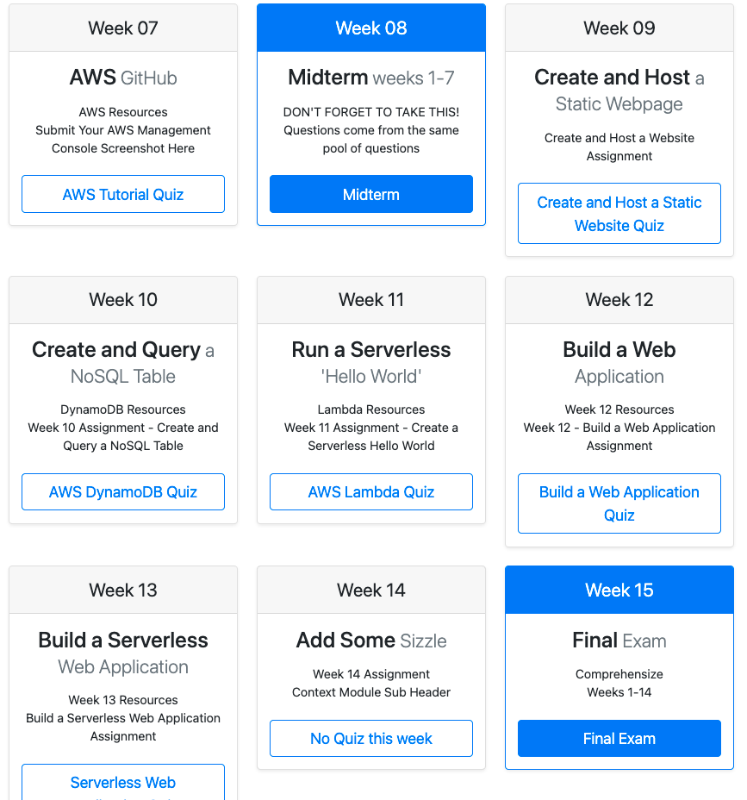
The ‘Pricing’ example reimagined

Slide 13
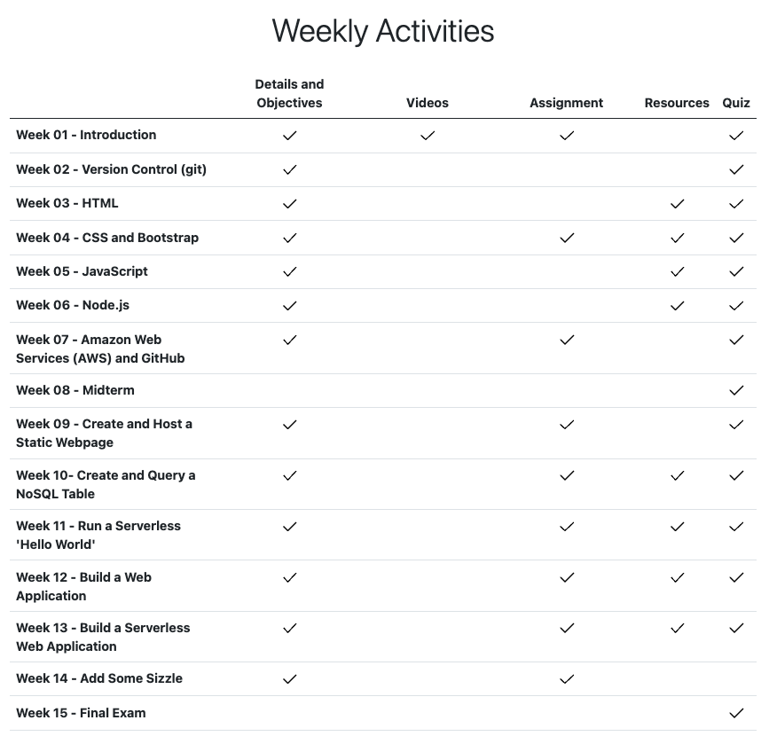
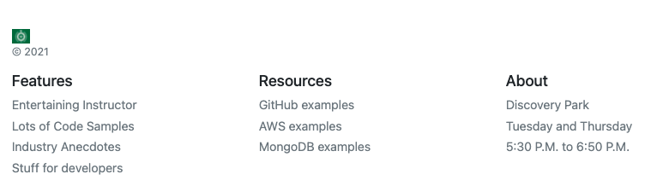

Slide 14
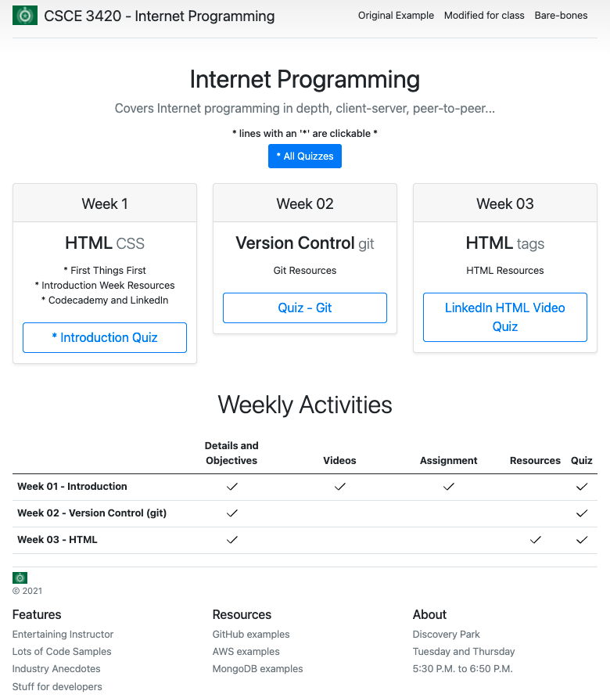
Stripped down
I don’t want to overwhelm you with examples
This page has just a few of each style
Looking at the HTML should not be too much to absorb

Slide 15
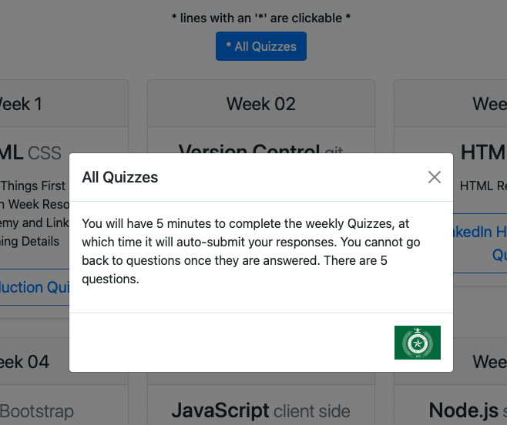
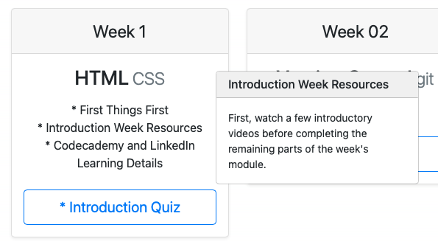
With a few extras found in the Cheat sheet example
Added in a modal for the quizzes button
And popovers for the weekly topics

Slide 16
Export an App to AWS

Slide 17
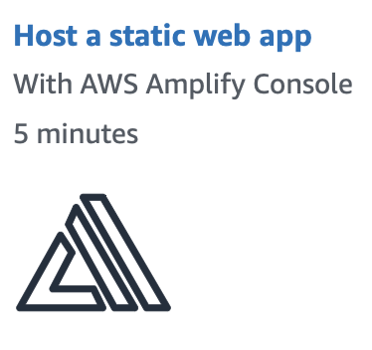
Let’s build a static web app
https://aws.amazon.com/getting-started/hands-on/host-static-website/

Slide 18
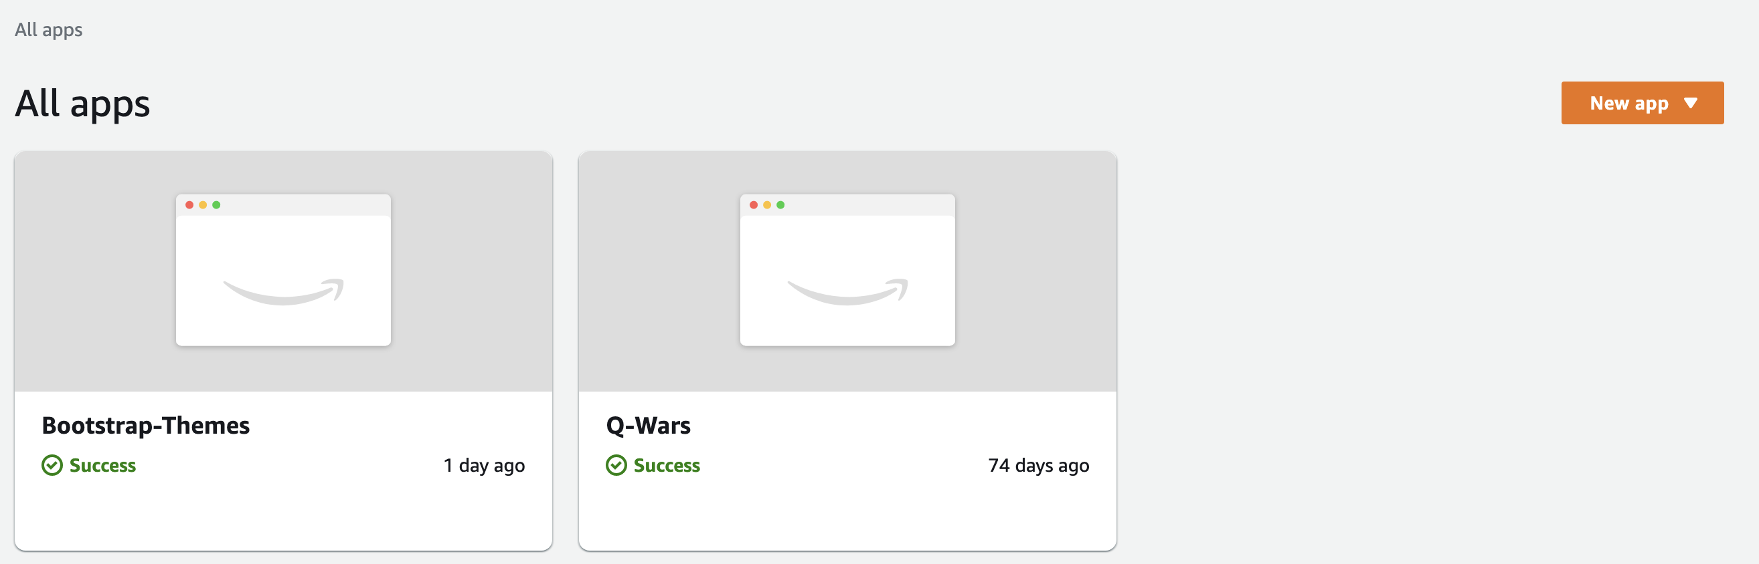
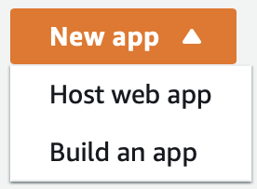
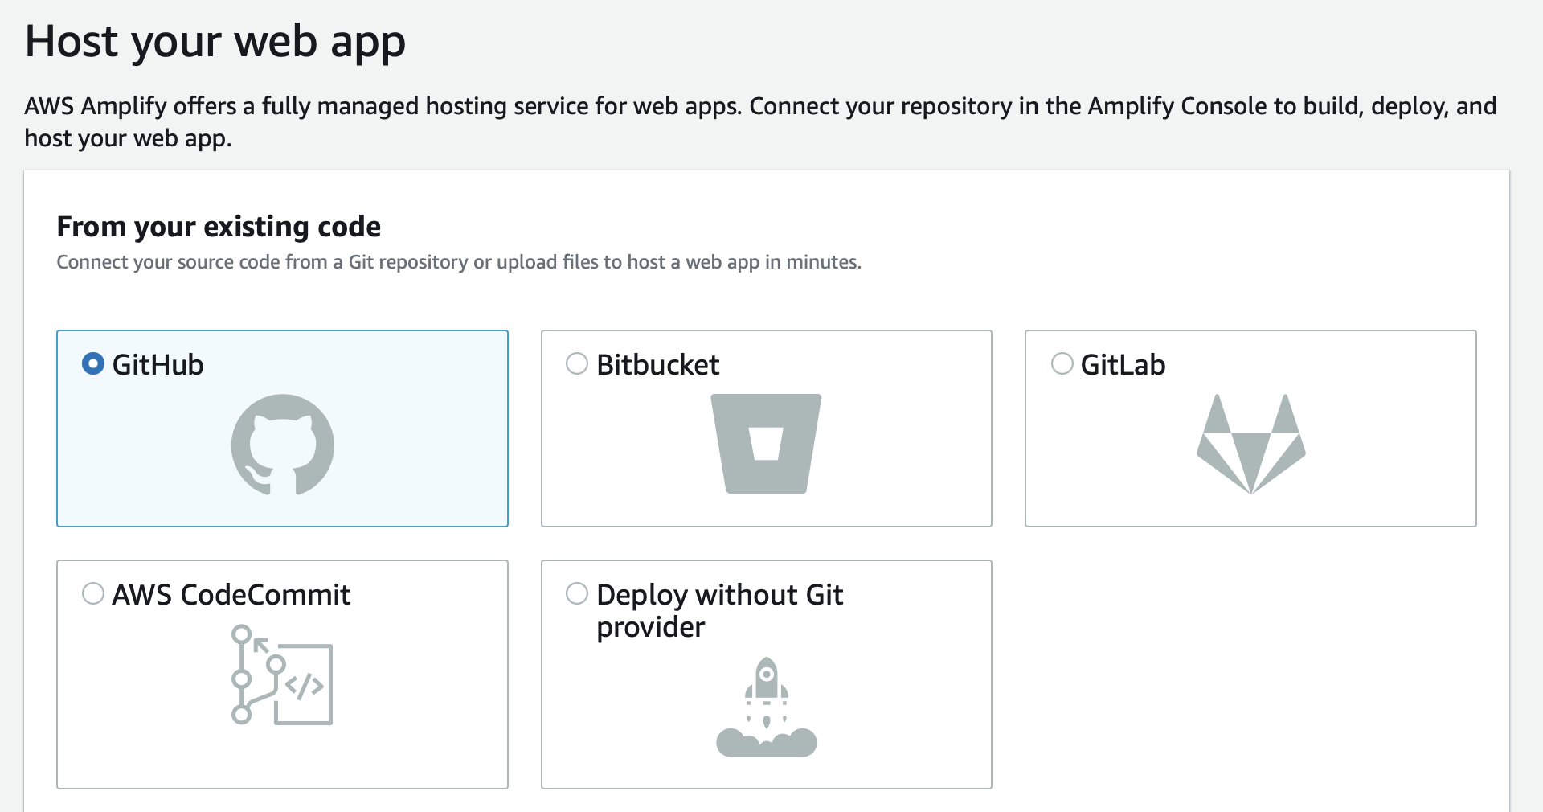
Amplify Console
In the Amplify console
Choose New App
Choose GitHub as the source for the code

Slide 19
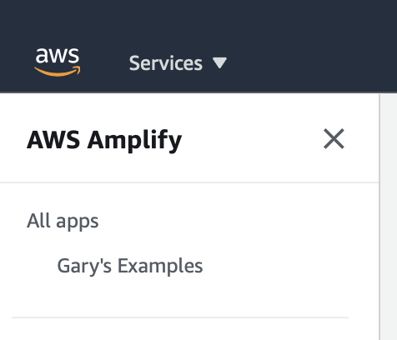
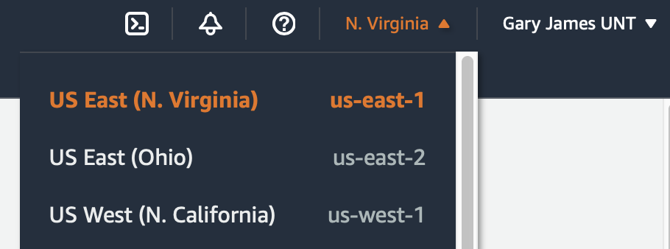
Amplify Console
Note your URL:
https://us-east-2.console.aws.amazon.com/amplify/home?region=us-east-2#/
It has your region specified

Slide 20
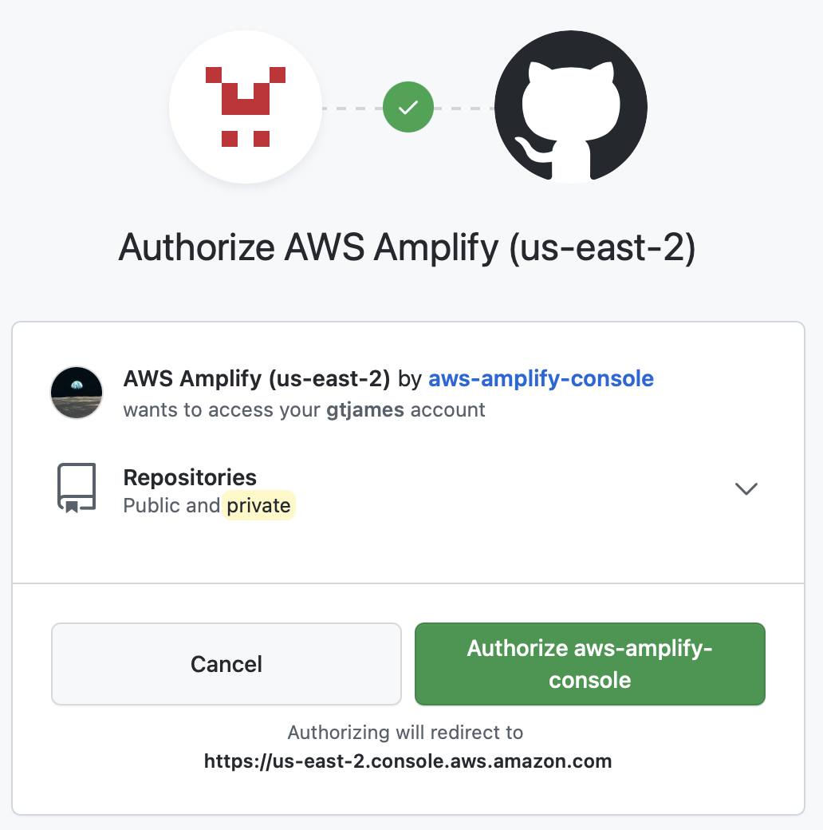
Connect to GitHub
You will sign into GitHub to tie your two accounts together

Slide 21
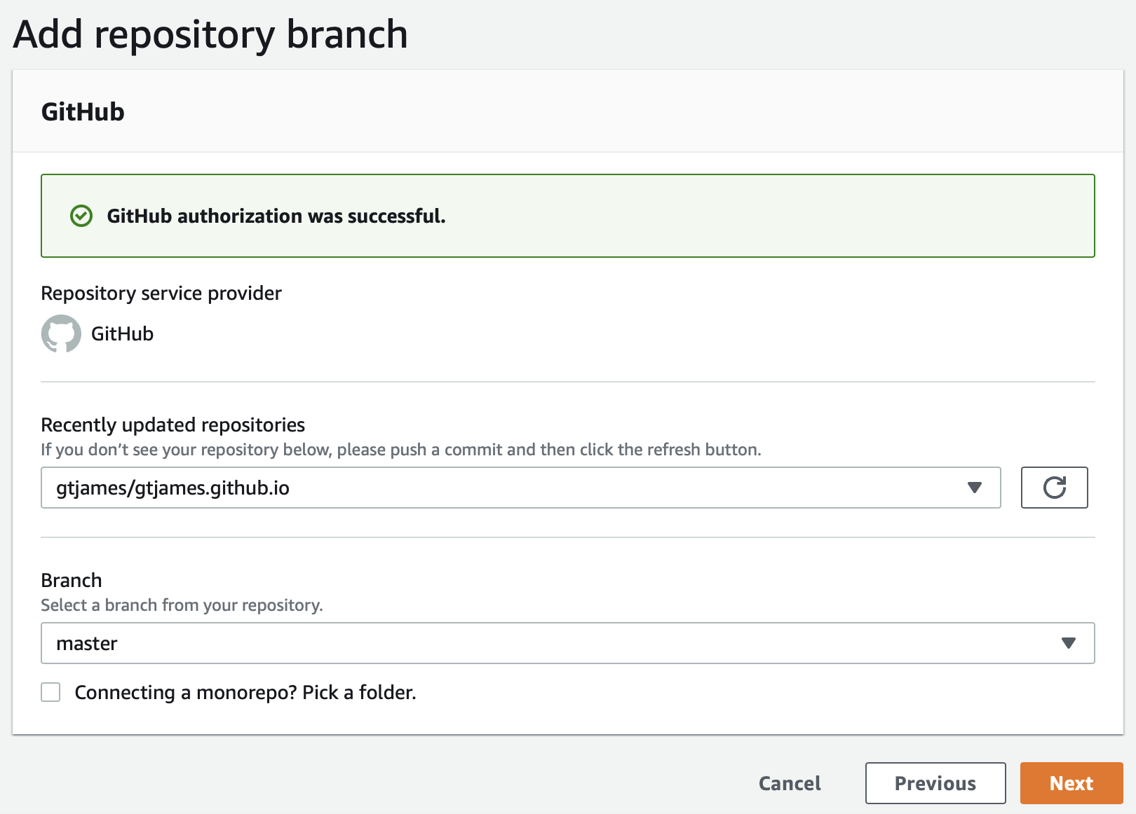
Add repository branch
AWS will make an API call out to GitHub to get a list of all of your repos
The Recently updated repositories drop down will be loaded in date order
You can also choose which BRANCH to deploy.

Slide 22
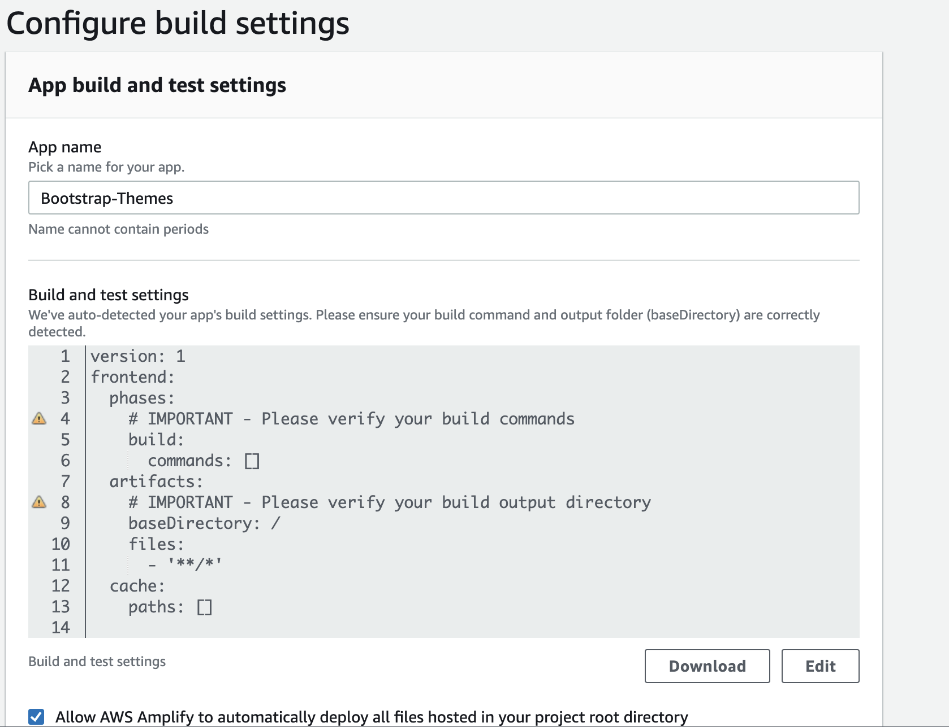
Configure build settings
Nothing needs to be altered here
Do check the box to allow automatically deploy

Slide 23
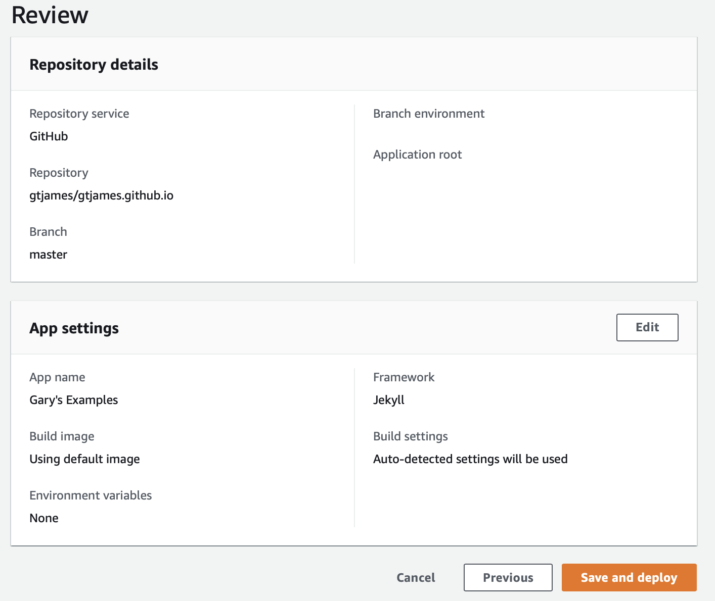
Review and Deploy!

Slide 24
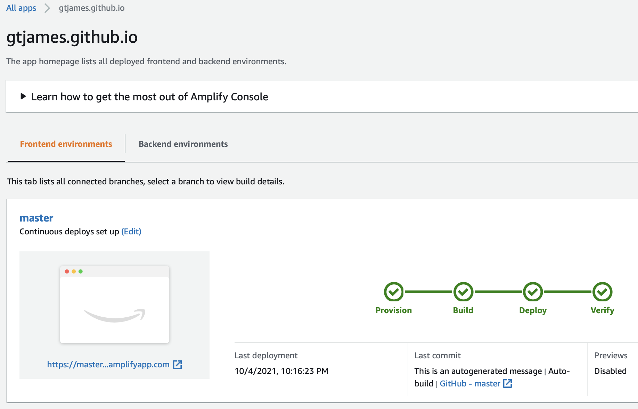
The workflow to move your code to AWS begins
Takes 2 or 3 minutes to deploy
You can watch the page at is goes through each step

Slide 25
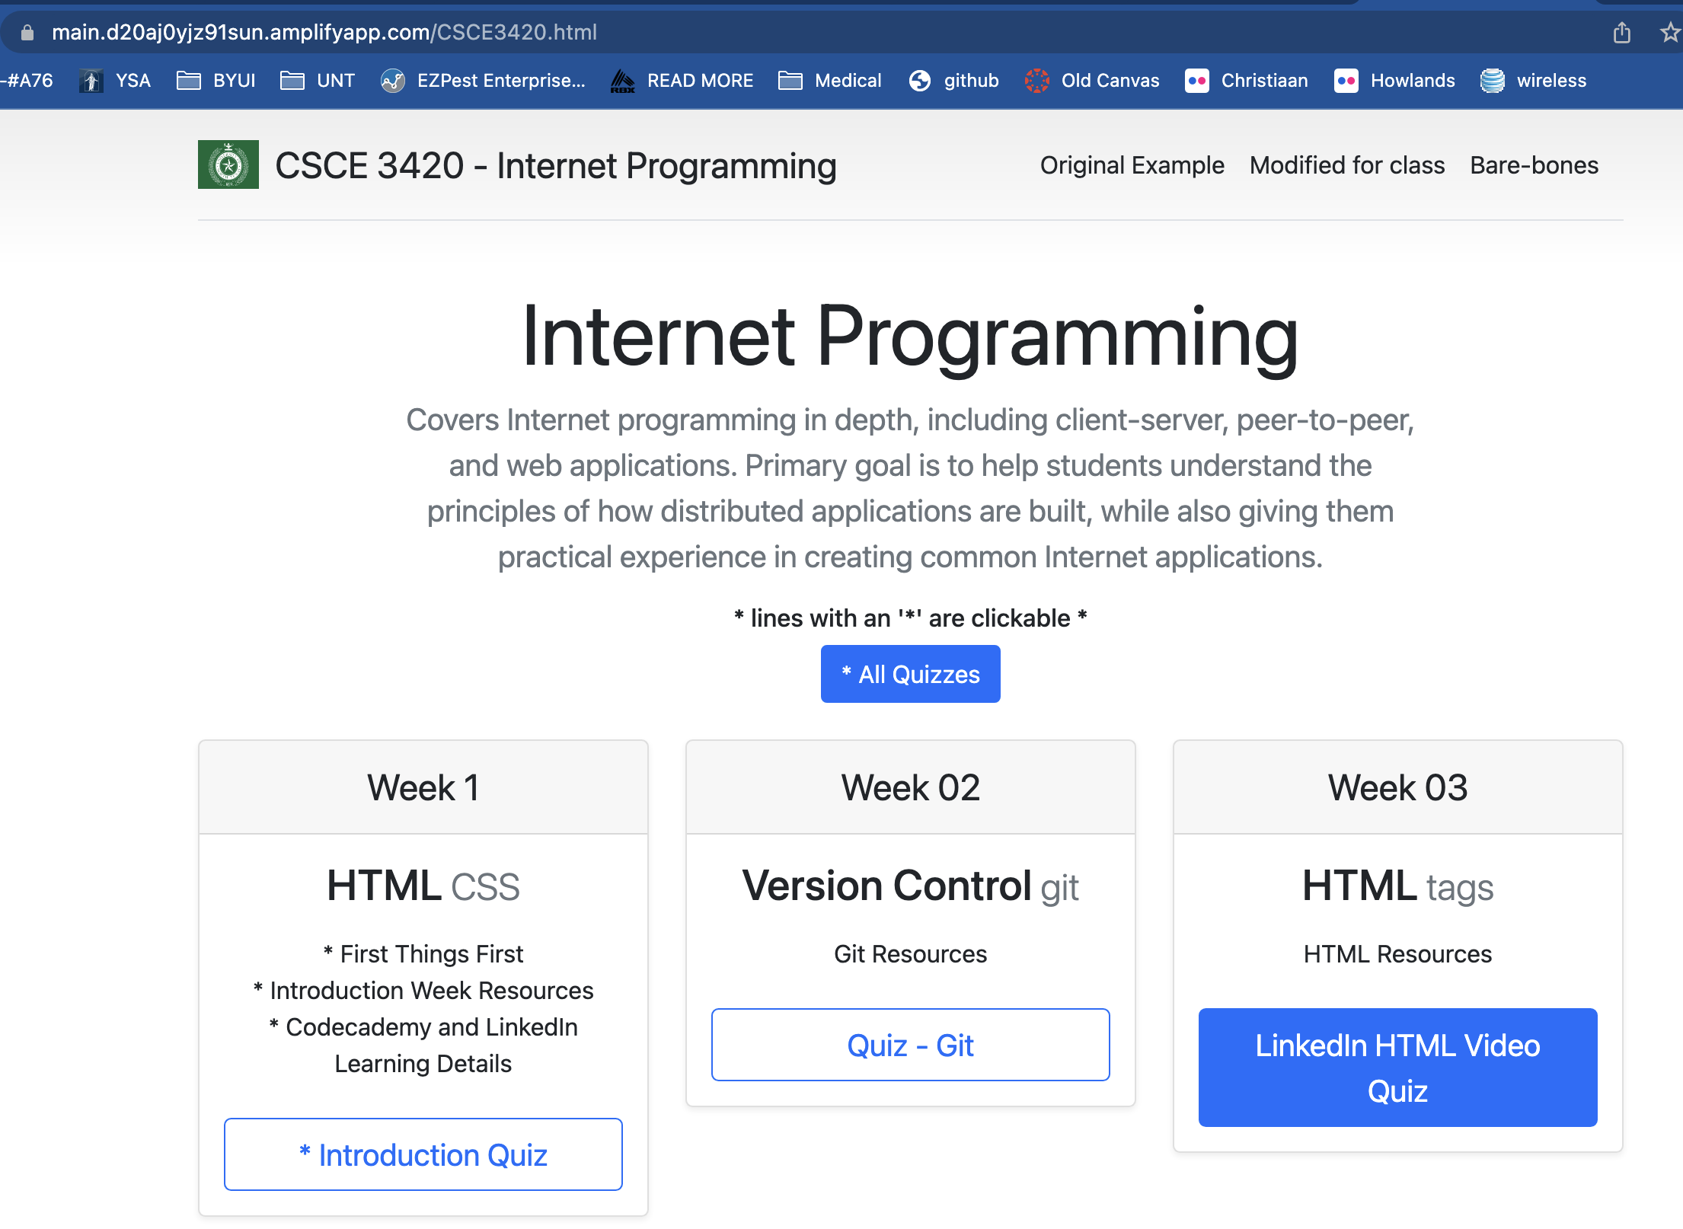
Click on the provided link and test your app

Slide 26
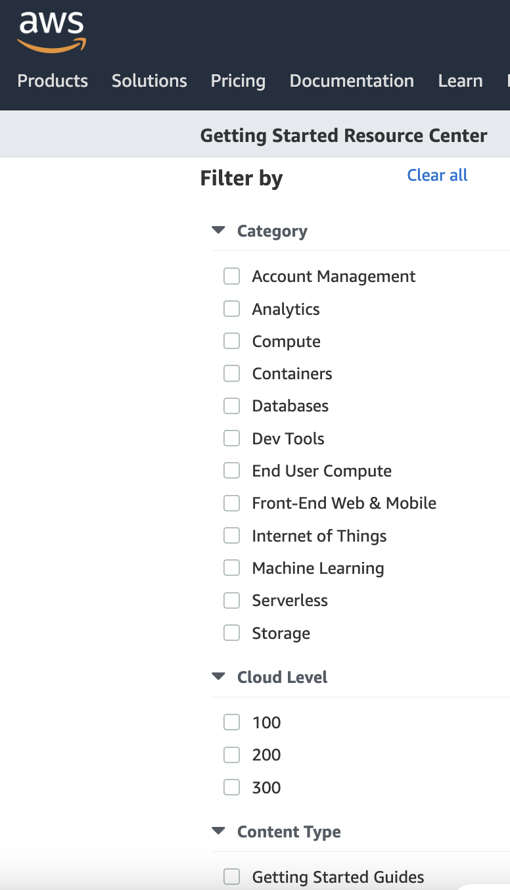
Head to the Development Center for more tutorials
https://aws.amazon.com/developer/?nc1=f_dr

Slide 27
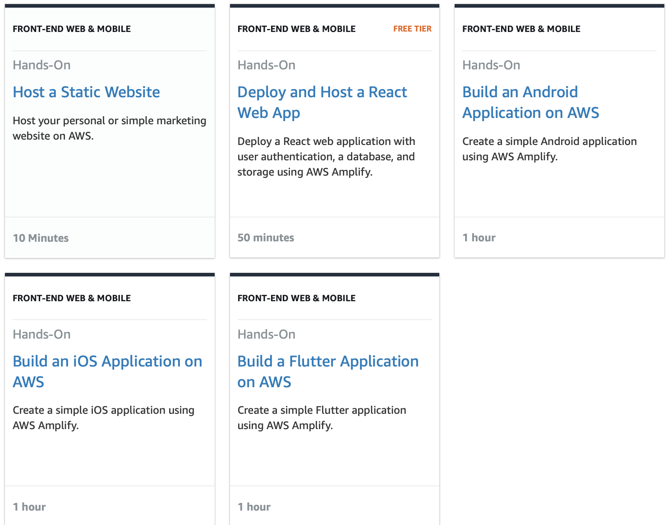
Find the hands-on tutorials for your AWS needs

